Slide 1
Compound assignment operator +=
Heap
Stack
String s1 = "Hello ";
s1
AR main
‘H’
.
6
‘E’
storageM
length
‘L’
‘L’
‘0’
‘ ’

Slide 2
Compound assignment operator +=
Heap
Stack
String s1 = "Hello ";
String s2 = "World";
s1 += s2; OR
s1.operator+=(s2);
String& String::operator += (const String& s)
‘W’
‘O’
s2
‘R’
‘L’
s1
‘D’
‘\0’
.
5
AR main
‘H’
.
6
storageM
length
‘E’
storageM
length
‘L’
‘L’
‘0’
‘ ’

Slide 3
Compound assignment operator +=
Heap
Stack
String s1 = "Hello ";
String s2 = "World";
s1 += s2; OR
s1.operator+=(s2);
this
s
String& String::operator += (const String& s)
‘W’
‘O’
s2
‘R’
‘L’
s1
‘D’
‘\0’
.
5
AR main
‘H’
.
6
storageM
length
‘E’
storageM
length
‘L’
‘L’
‘0’
‘ ’

Slide 4
Compound assignment operator +=
Heap
Stack
String s1 = "Hello ";
String s2 = "World";
s1 += s2; OR
s1.operator+=(s2);
this
s
String& String::operator += (const String& s)
length += s.length;
‘W’
‘O’
s2
‘R’
‘L’
s1
‘D’
‘\0’
.
5
AR main
‘H’
.
11
storageM
length
‘E’
storageM
length
‘L’
‘L’
‘0’
‘ ’

Slide 5
Compound assignment operator +=
Heap
Stack
p
String s1 = "Hello ";
String s2 = "World";
s1 += s2; OR
s1.operator+=(s2);
.
12
storageM
length
this
s
String& String::operator += (const String& s)
length += s.length;
char *p = new char[length + 1];
‘W’
‘O’
s2
‘R’
‘L’
s1
‘D’
‘\0’
.
5
AR main
‘H’
.
11
storageM
length
‘E’
storageM
length
‘L’
‘L’
‘0’
‘ ’

Slide 6
Compound assignment operator +=
Heap
Stack
p
String s1 = "Hello ";
String s2 = "World";
s1 += s2; OR
s1.operator+=(s2);
‘H’
.
12
‘E’
storageM
length
‘L’
this
s
‘L’
‘0’
‘ ’
String& String::operator += (const String& s)
length += s.length;
char *p = new char[length + 1];
assert(p != 0);
strcpy(p, storageM);
‘W’
‘O’
s2
‘R’
‘L’
s1
‘D’
‘\0’
.
5
AR main
‘H’
.
11
storageM
length
‘E’
storageM
length
‘L’
‘L’
‘0’
‘ ’

Slide 7
Compound assignment operator +=
Heap
Stack
‘H’
p
String s1 = "Hello ";
String s2 = "World";
s1 += s2; OR
s1.operator+=(s2);
‘E’
‘L’
.
12
‘L’
‘0’
storageM
length
‘ ’
this
s
‘W’
‘O’
‘R’
‘L’
‘D’
String& String::operator += (const String& s)
length += s.length;
char *p = new char[length + 1];
assert(p != 0);
strcpy(p, storageM);
strcat(p, s.storageM);
‘\0’
‘W’
‘O’
s2
‘R’
‘L’
s1
‘D’
‘\0’
.
5
AR main
‘H’
.
11
storageM
length
‘E’
storageM
length
‘L’
‘L’
‘0’
‘ ’

Slide 8
Compound assignment operator +=
Heap
Stack
‘H’
p
String s1 = "Hello ";
String s2 = "World";
s1 += s2; OR
s1.operator+=(s2);
‘E’
‘L’
.
12
‘L’
‘0’
storageM
length
‘ ’
this
s
‘W’
‘O’
‘R’
‘L’
‘D’
String& String::operator += (const String& s)
length += s.length;
char *p = new char[length + 1];
assert(p != 0);
strcpy(p, storageM);
strcat(p, s.storageM);
delete storageM;
‘\0’
‘W’
‘O’
s2
‘R’
‘L’
s1
‘D’
‘\0’
.
5
AR main
.
11
storageM
length
storageM
length

Slide 9
Compound assignment operator +=
Heap
Stack
‘H’
p
String s1 = "Hello ";
String s2 = "World";
s1 += s2; OR
s1.operator+=(s2);
‘E’
‘L’
.
12
‘L’
‘0’
storageM
length
‘ ’
this
s
‘W’
‘O’
‘R’
‘L’
‘D’
String& String::operator += (const String& s)
length += s.length;
char *p = new char[length + 1];
assert(p != 0);
strcpy(p, storageM);
strcat(p, s.storageM);
delete storageM;
storageM = p;
‘\0’
‘W’
‘O’
s2
‘R’
‘L’
s1
‘D’
‘\0’
.
5
AR main
.
11
storageM
length
storageM
length

Slide 10
Compound assignment operator +=
Heap
Stack
‘H’
p
String s1 = "Hello ";
String s2 = "World";
s1 += s2; OR
s1.operator+=(s2);
‘E’
‘L’
.
12
‘L’
‘0’
storageM
length
‘ ’
this
s
‘W’
‘O’
‘R’
‘L’
‘D’
String& String::operator += (const String& s)
length += s.length;
char *p = new char[length + 1];
assert(p != 0);
strcpy(p, storageM);
strcat(p, s.storageM);
delete storageM;
storageM = p;
‘\0’
‘W’
‘O’
s2
‘R’
‘L’
s1
‘D’
‘\0’
.
5
AR main
.
11
storageM
length
storageM
length

Slide 11
Compound assignment operator +=
Heap
‘H’
String s1 = "Hello ";
String s2 = "World";
s1 += s2; OR
s1.operator+=(s2);
‘E’
‘L’
‘L’
‘0’
‘ ’
‘W’
‘O’
‘R’
‘L’
‘D’
String& String::operator += (const String& s)
length += s.length;
char *p = new char[length + 1];
assert(p != 0);
strcpy(p, storageM);
strcat(p, s.storageM);
delete storageM;
storageM = p;
return *this;
‘\0’
‘W’
‘O’
s2
‘R’
‘L’
s1
‘D’
‘\0’
.
5
AR main
.
12
storageM
length
storageM
length

Slide 12
Why do we need the << operator for the String class?
String s = "Hello";
std::cout << s;

Slide 13
What type of object is on the left side of the operator <<?
std::cout << s;

Slide 14
What type of object is on the right side of the operator <<?
std::cout << s;

Slide 15
What type of object should be returned from the << operator function?
std::cout << s1 << s2;

Slide 16
Should this overloaded operator function be a member of the String class?
Not be a member function of the String class,
A non-member function or a friend function.

Slide 17
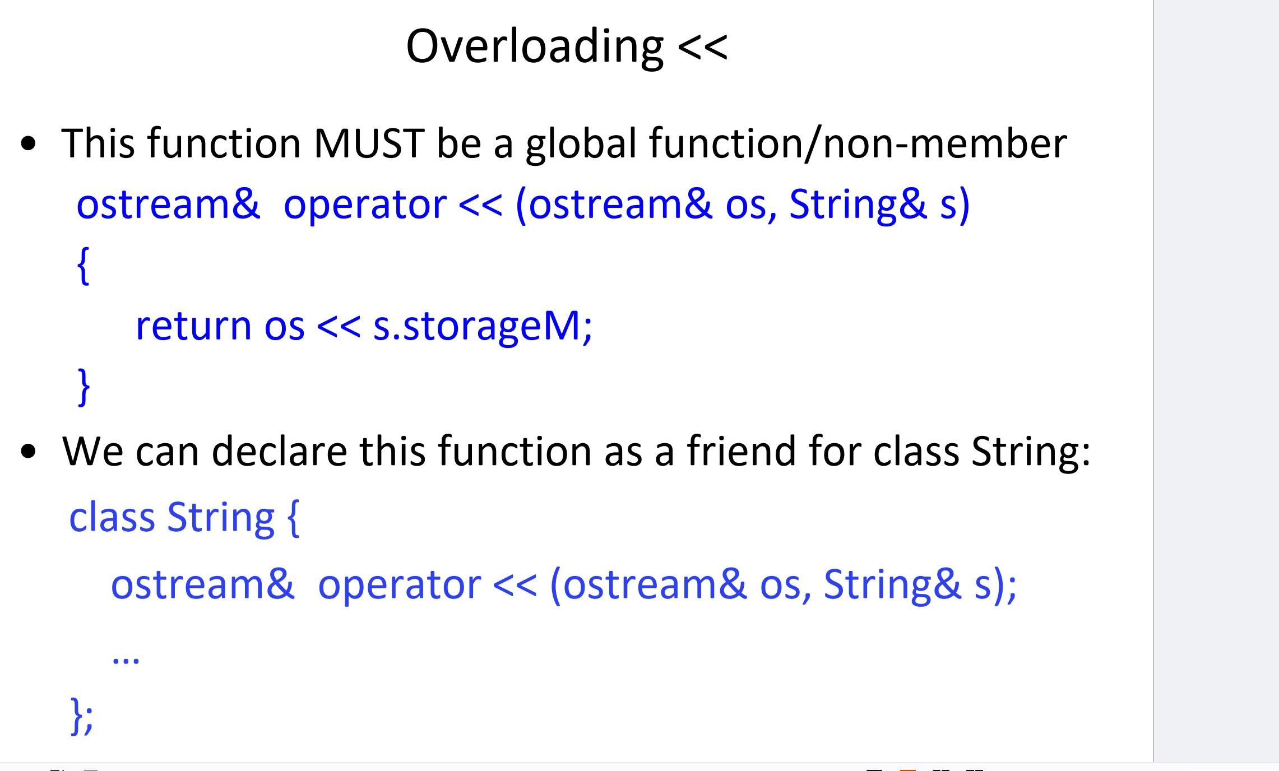
String s("Hello");
std::cout << s;
class String {
friend ostream& operator << (ostream& os, String& s);
// other members of the class...
};

Slide 18
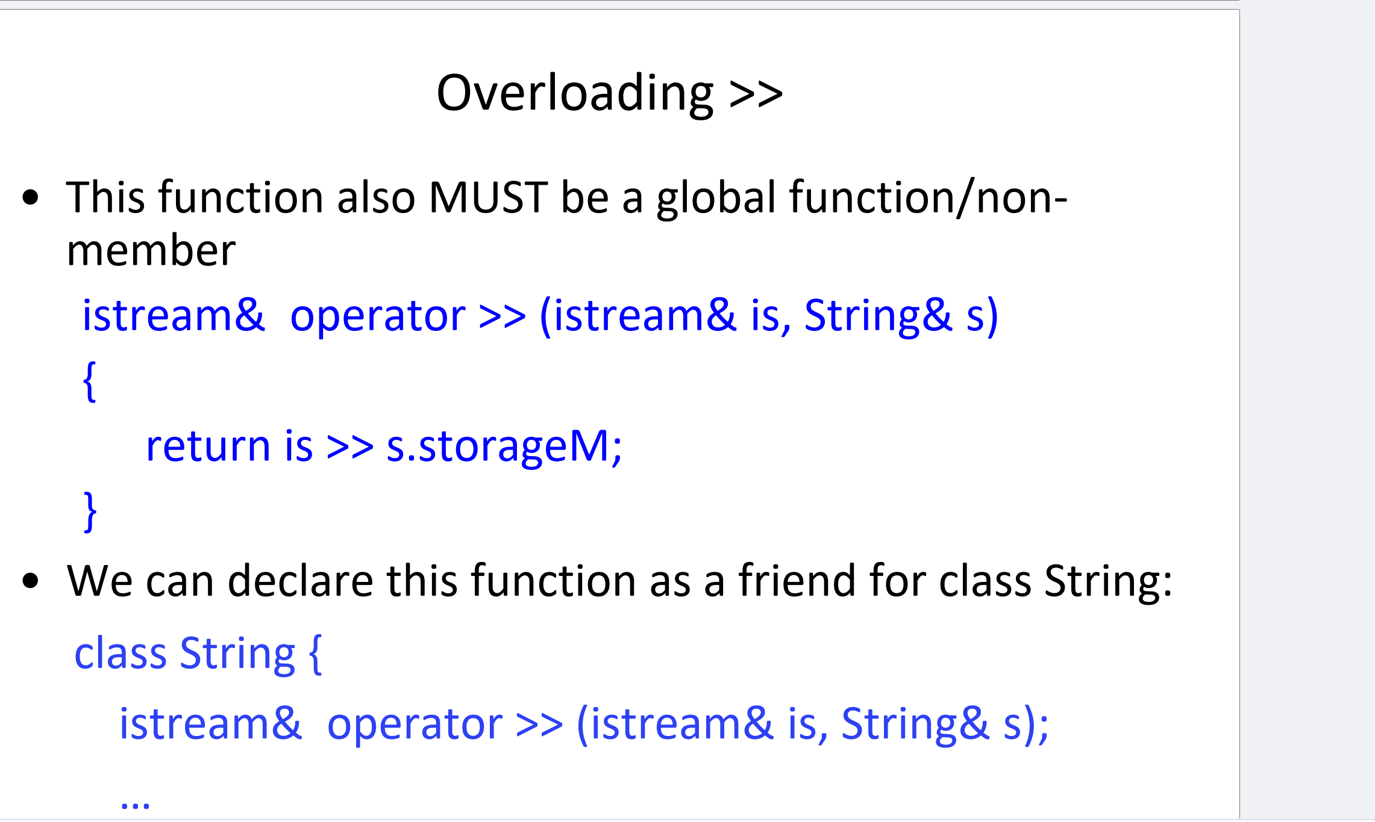
String s1; // Create a String object
// Input a string into s1
cout << "Enter your name: ";
cin >> s1; // User types "Alice"
// Output the string stored in s1
cout << "Your name is: " << s1
class String {
friend istream& operator >> (istream& is, String& s);
// other members of the class...
};

Slide 19
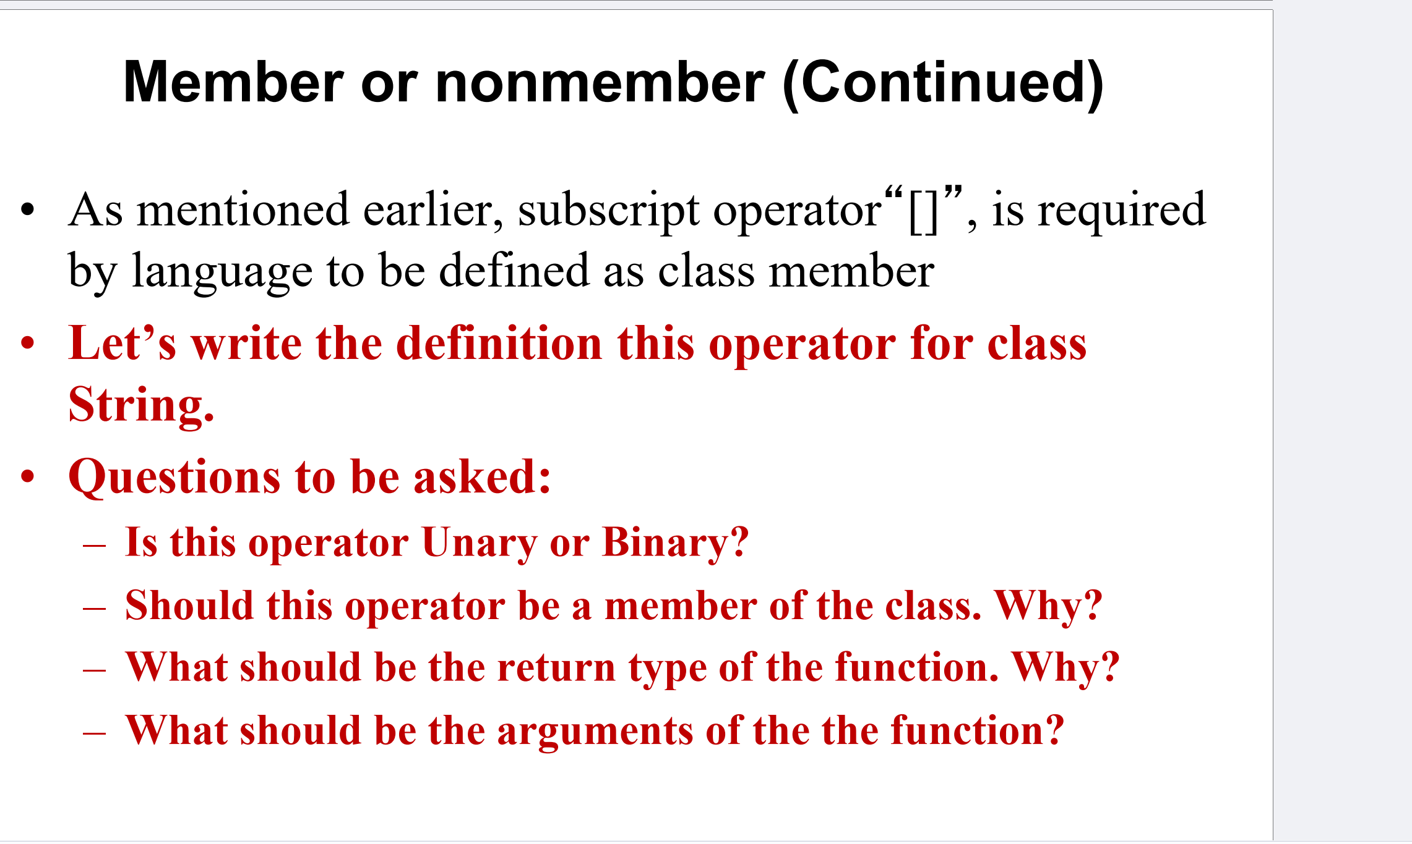

Slide 20
Is this operator Unary or Binary?
s[3]

Slide 21
Should this operator be a member of the class?
Directly accesses the internal data of the class

Slide 22
What should be the return type of the function? Why?
s[0] = 'A'; // Modify the first character of the string

Slide 23
What should be the arguments of the function?
index (typically an int or size_t)

Slide 24
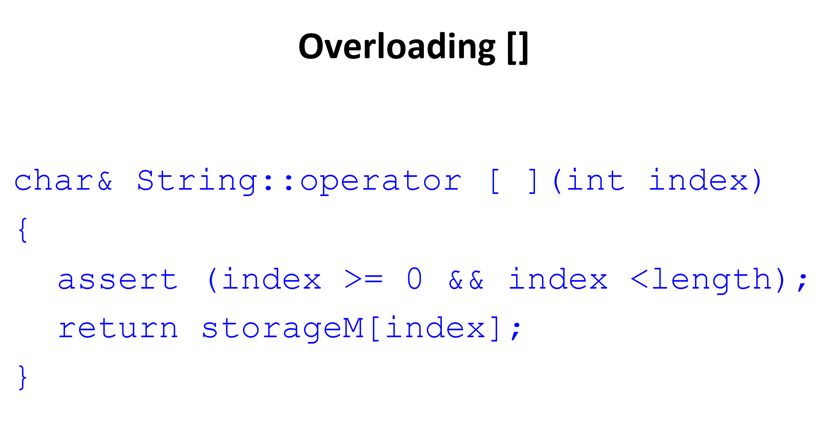
String s("Hello"); // Create a String object initialized with "Hello"
cout << s[0];
s.storageM points to the character array {'H', 'e', 'l', 'l', 'o', '\0'}

Slide 25
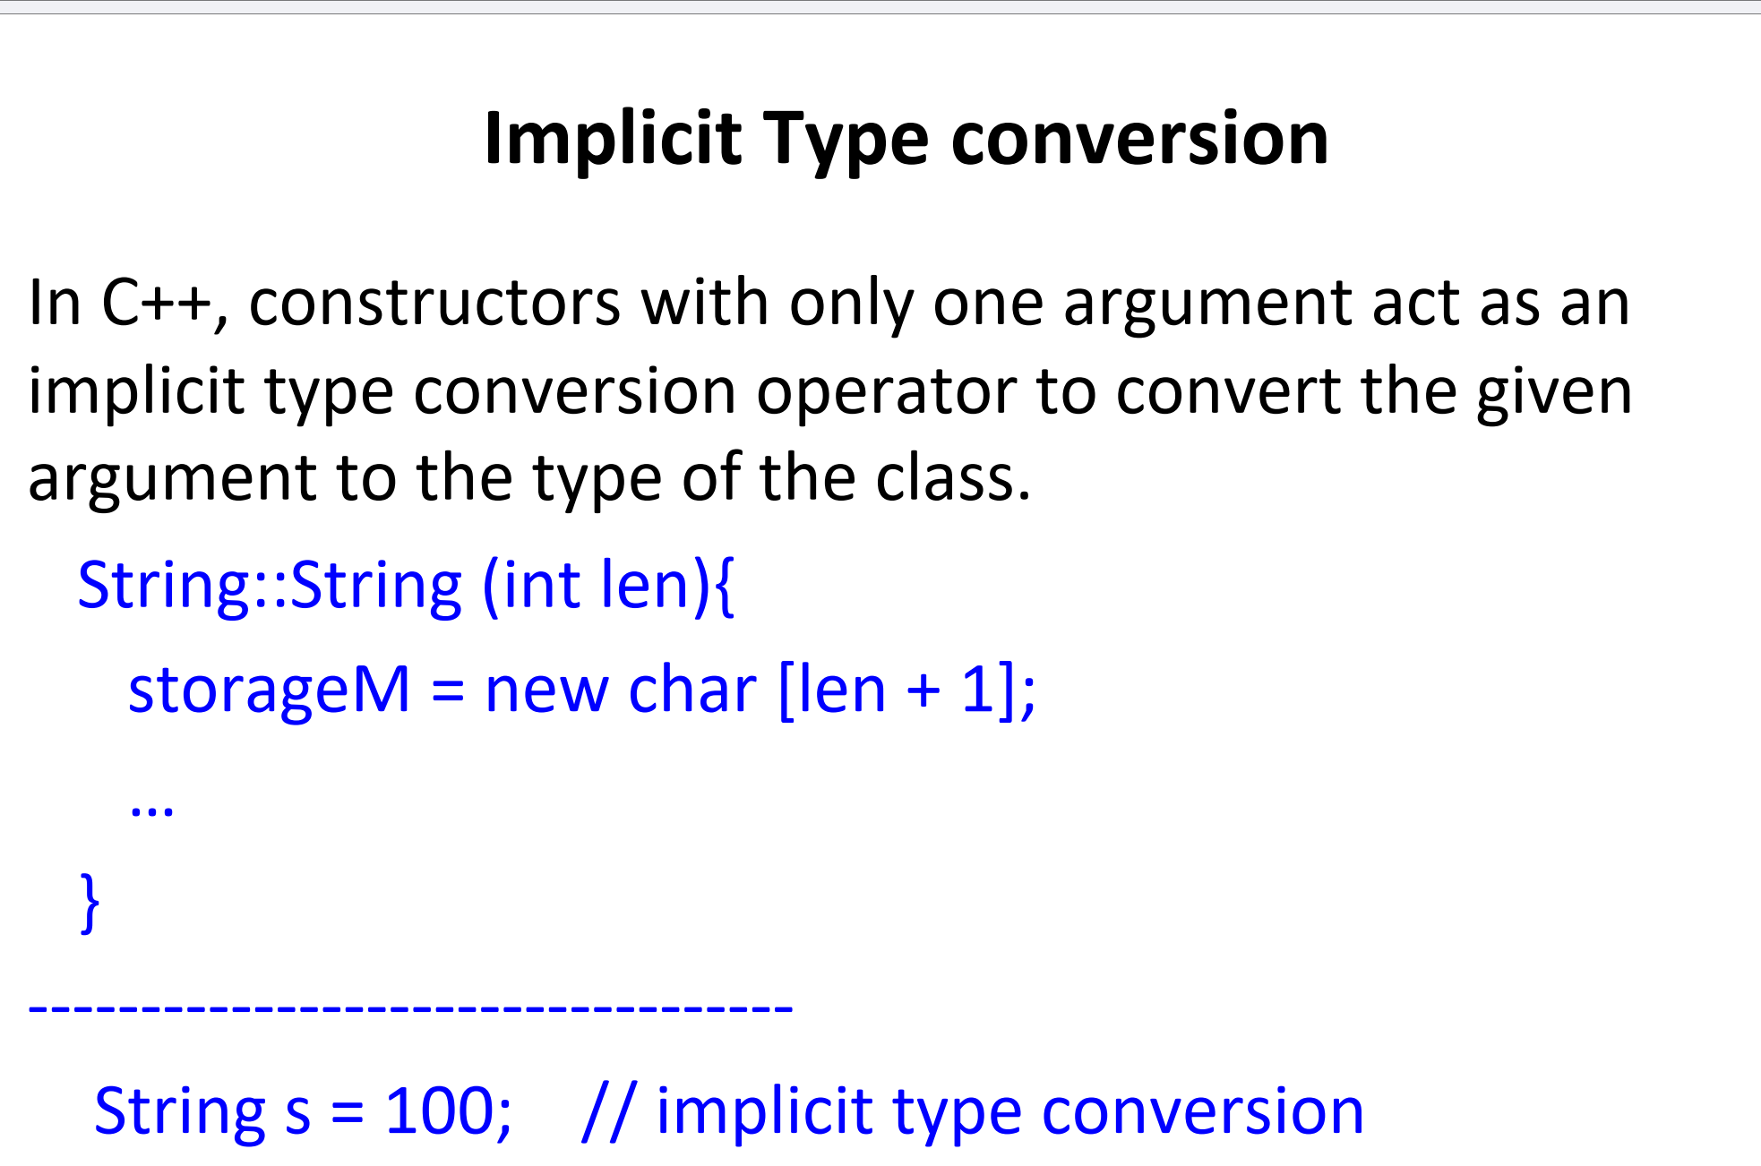

Slide 26
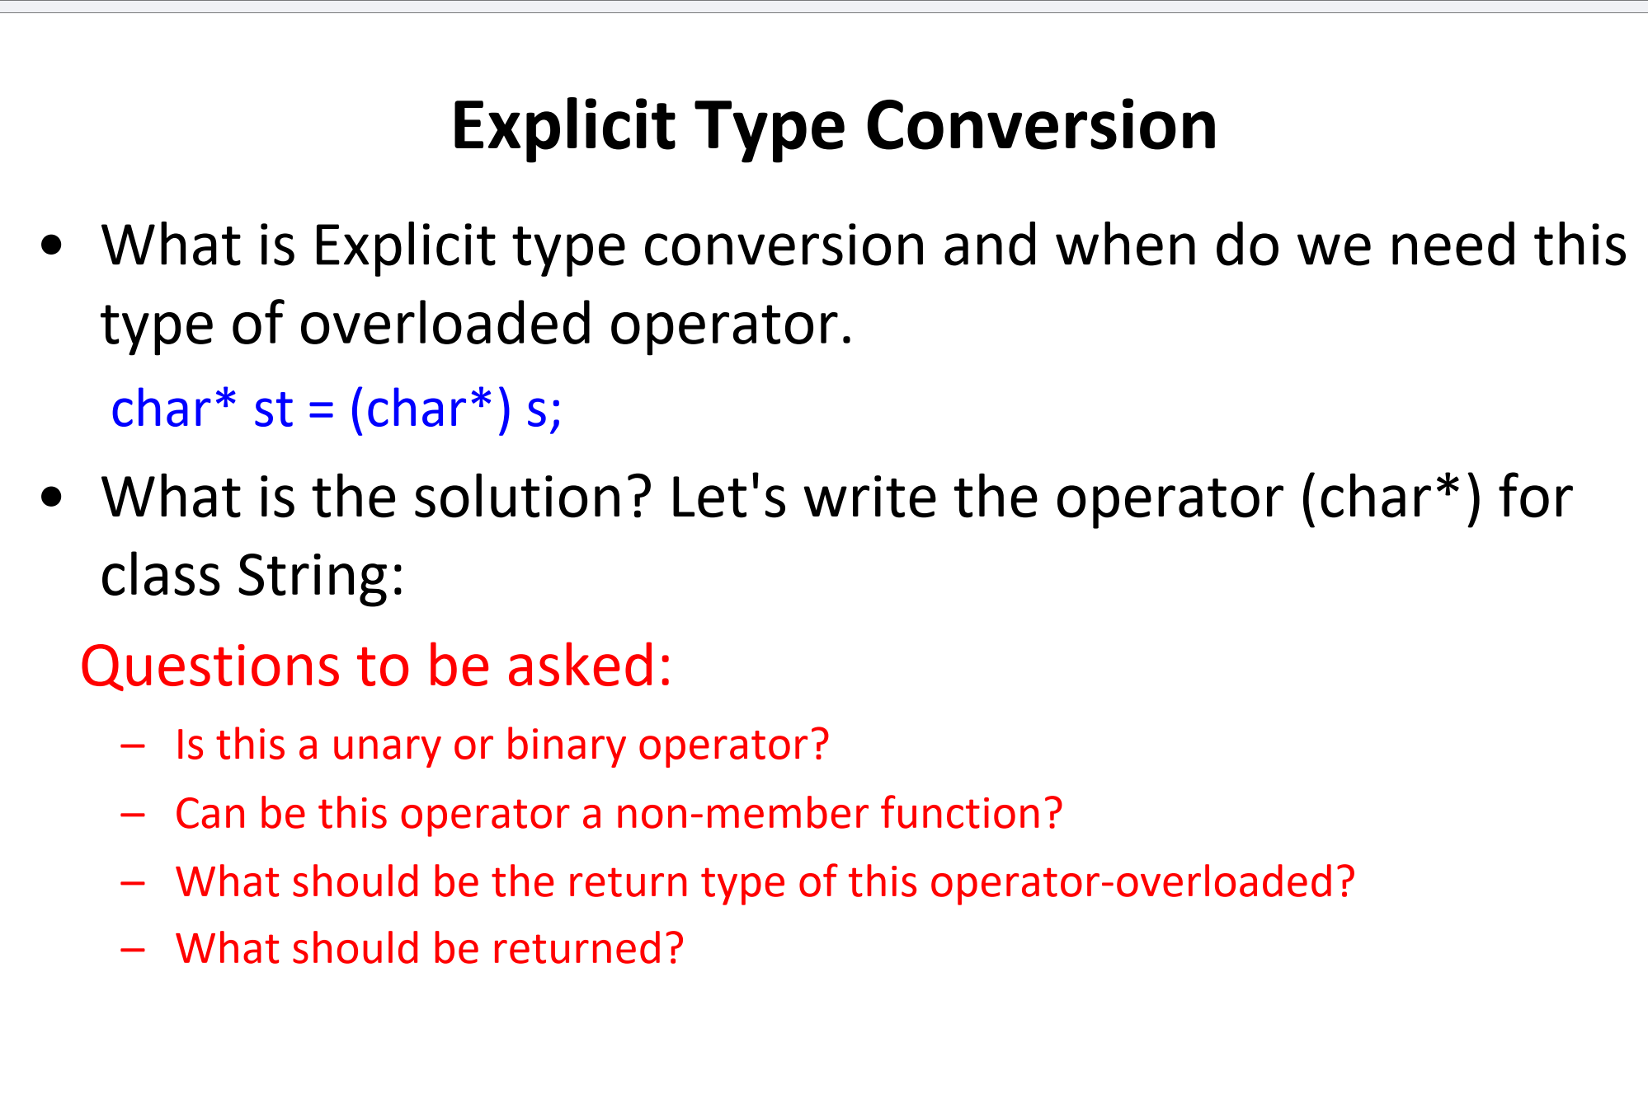

Slide 27
Questions to Consider:
Is this a unary or binary operator?
Unary operator
Can this operator be a non-member function?
No
What should be the return type of this operator-overloaded?
What should be returned?

Slide 28
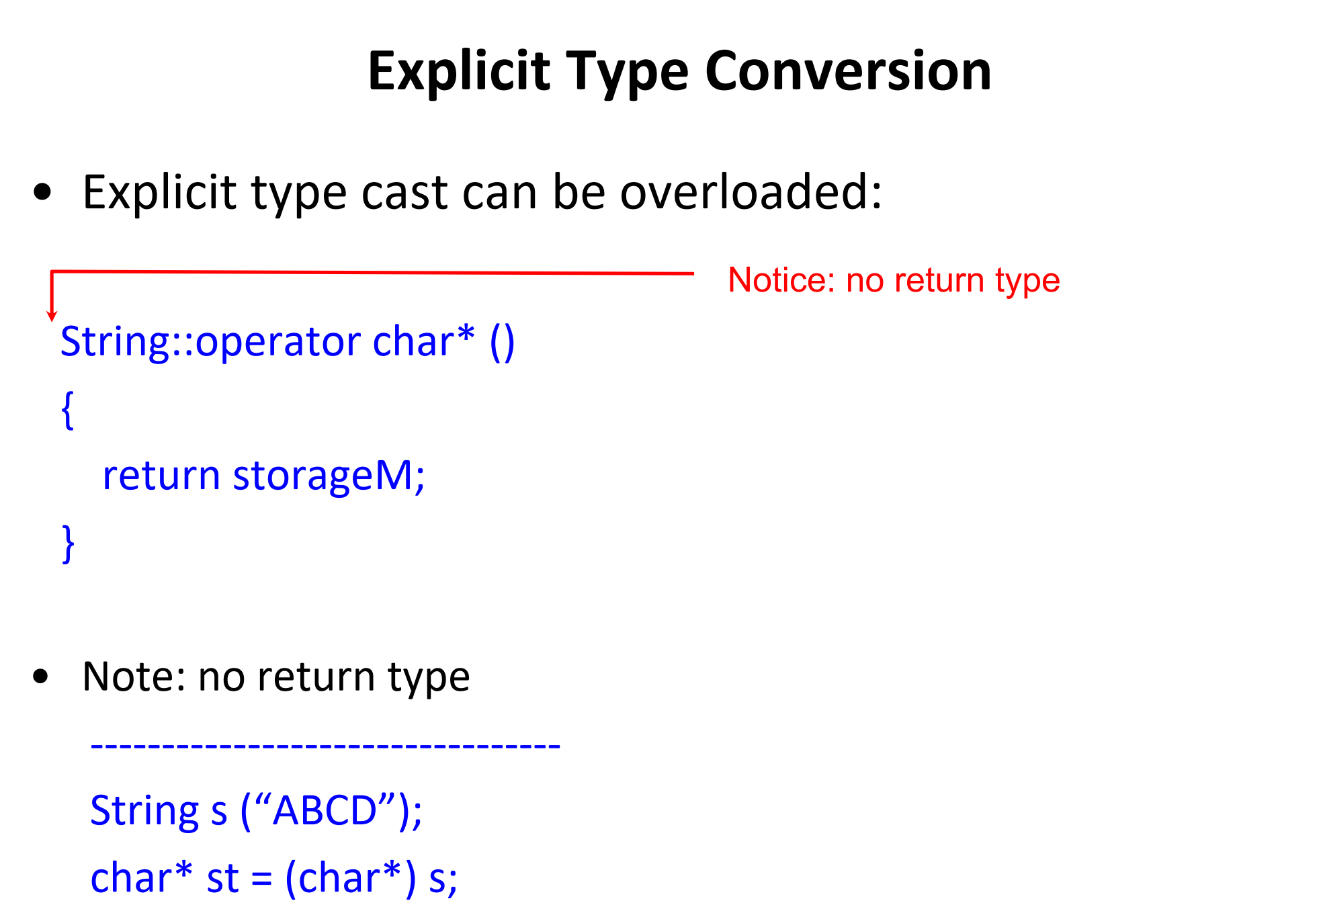
operator int() {
return 42;
}

Slide 29
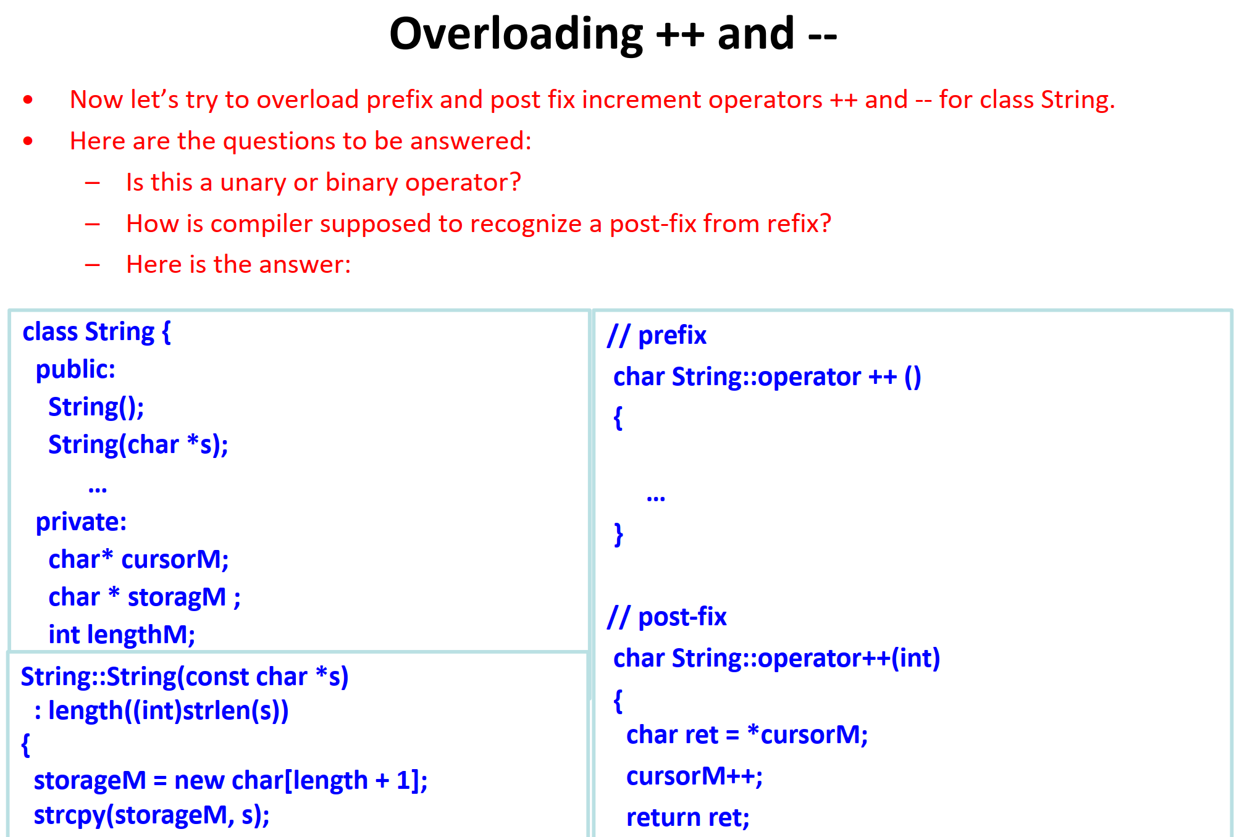

Slide 30
String s("Hello World");
++s
// Logic for prefix increment
cursorM++; // Move the cursor to the next character
return *cursorM;}
cursorM = storageM;

